Slide 1

TOC Project — Simple Turing Machine Simulator
A compact, educational Turing Machine simulator built in a single C++ file. This project makes theoretical computer science concepts tangible and interactive for students and educators.
Mentor: Dr. Jagdish Chakole
BT23CSE023, BT23CSE026, BT23CSE037, BT23CSE046, BT23CSE053
Git Hub Link: Repoistory Link
Notes:
1

Slide 2
TOC Project — Simple Turing Machine Simulator
A compact, educational Turing Machine simulator built in a single C++ file. This project makes theoretical computer science concepts tangible and interactive for students and educators.
Single File Design
Flexible Input
Complete simulator in tm.cpp - readable, maintainable, and easy to understand
Load machines from built-in examples or custom .tm files like string_duplicate.tm
Interactive Modes
Step through execution one transition at a time or run automatically to completion
Notes:
2

Slide 3




Goals and Motivation
This project bridges the gap between theoretical computer science and hands-on learning. By providing an approachable, interactive platform, students can experiment with Turing Machines without getting lost in implementation complexity.
The human-readable .tm file format enables easy sharing and collaboration, while the dual-mode execution supports both detailed inspection and automated testing workflows.
Educational Focus
Clear Format
Flexible Execution
Make Turing Machines approachable and playable for students exploring computational theory
Provide a standardized .tm format for sharing and documenting machine definitions
Offer both interactive stepping for learning and automated runs for comprehensive testing
The sparse tape implementation efficiently handles machines with large-index head movements, while explicit implicit-reject behavior on missing transitions ensures predictable execution.
Notes:
3

Slide 4


Implementation Highlights
Single-File Architecture
Efficient Sparse Tape
Complete C++17 implementation in tm.cpp with readable parser and simulator logic
Uses unordered_map<long long, char> to store only non-blank cells, enabling efficient memory usage
Simple Parser
Runtime Features
Parses .tm files with clear headers (states, start, accept, reject) and delta transitions
Includes pretty() visualization, last rule display, and configurable step cap support
Key Data Structures: The Rule structure captures state transitions, while the TM structure maintains machine configuration. The delta map efficiently looks up transitions based on current state and tape symbol.
The sparse tape design is particularly elegant—it simplifies memory management and allows the head to move to arbitrarily large indices without pre-allocating massive arrays.
Notes:
4

Slide 5





Build & Run Examples
Build with g++
g++ -std=c++17 -O2 tm.cpp -o tm.exe
Run Built-in Example
./tm.exe --example binary_incrementer --input 101 --run
Run Custom .tm File
./tm.exe --file string_duplicate.tm --input ab --run
Interactive Step Mode
./tm.exe --example anbn --input aabb --step
Press Enter to advance one step at a time
Git Bash works seamlessly with g++ builds. For MSVC users, remember to use the Developer Command Prompt. The typical workflow is straightforward: build the executable, run an example, and inspect the pretty() output to visualize tape evolution.
Notes:
5

Slide 6

Example Machines & Demo Plan
Included Examples
string_reversal - reverse the input string
palindrome_nosep - Checks palindromes w/o seperator
anbn - Recognizes a^n b^n language
unary_add - Performs unary addition
non_halting_right - Demonstrates infinite loops
string_duplicate.tm - Duplicates input string
Notes:
6

Slide 7
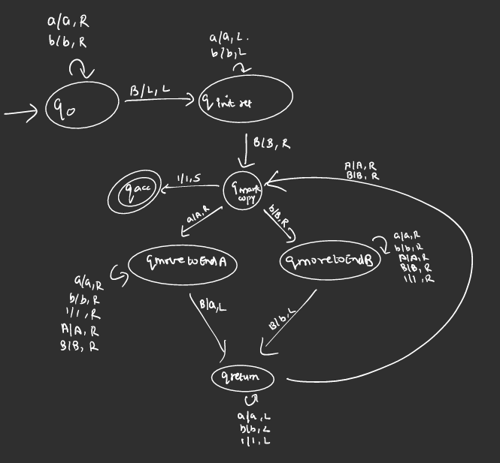
Example 1: String Duplication
string_reversal - reverse the input string
palindrome_nosep - Checks palindromes w/o seperator
anbn - Recognizes a^n b^n language
unary_add - Performs unary addition
non_halting_right - Demonstrates infinite loops
string_duplicate.tm - Duplicates input string
Transition diagram
Notes:
6

Slide 8
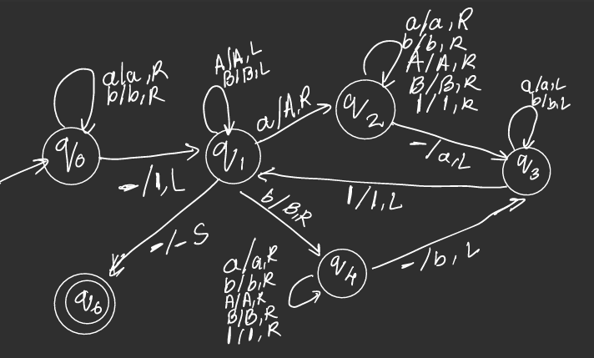
Example 2: String Reversal
string_reversal - reverse the input string
palindrome_nosep - Checks palindromes w/o seperator
anbn - Recognizes a^n b^n language
unary_add - Performs unary addition
non_halting_right - Demonstrates infinite loops
string_duplicate.tm - Duplicates input string
Transition diagram
Notes:
6

Slide 9
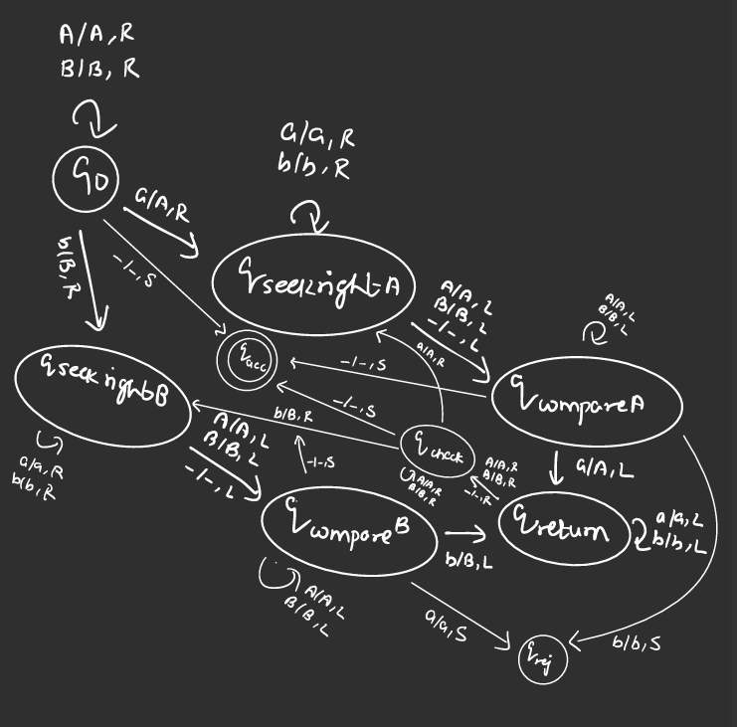
Example 3: Palindrome without seprator
string_reversal - reverse the input string
palindrome_nosep - Checks palindromes w/o seperator
anbn - Recognizes a^n b^n language
unary_add - Performs unary addition
non_halting_right - Demonstrates infinite loops
string_duplicate.tm - Duplicates input string
Transition diagram
Notes:
6

Slide 10
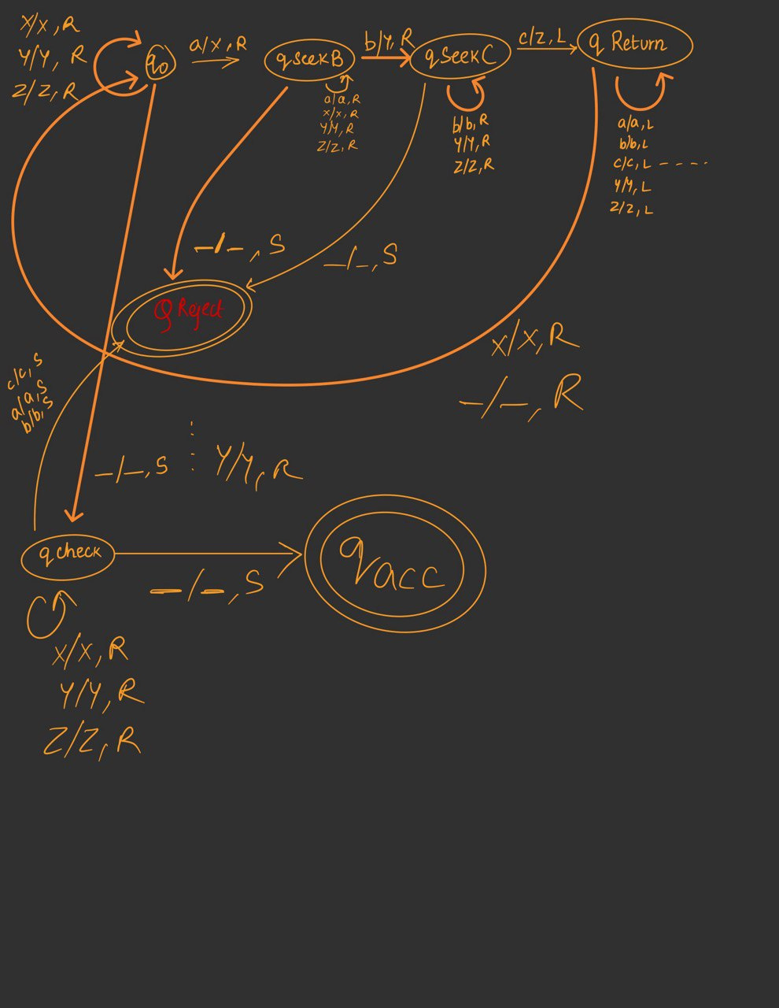
Example 4: equal abc’s
string_reversal - reverse the input string
palindrome_nosep - Checks palindromes w/o seperator
anbn - Recognizes a^n b^n language
unary_add - Performs unary addition
non_halting_right - Demonstrates infinite loops
string_duplicate.tm - Duplicates input string
Transition diagram
Notes:
6

Slide 11
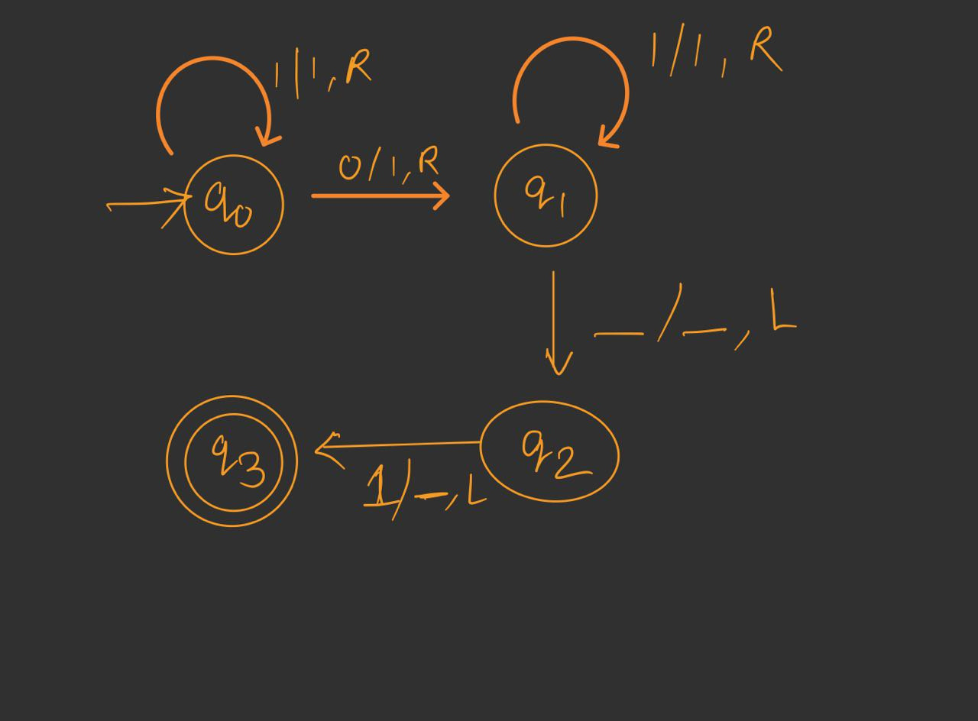
Example 5: Unary Additon
string_reversal - reverse the input string
palindrome_nosep - Checks palindromes w/o seperator
anbn - Recognizes a^n b^n language
unary_add - Performs unary addition
non_halting_right - Demonstrates infinite loops
string_duplicate.tm - Duplicates input string
Transition diagram
Notes:
6

Slide 12
Thank you !!

